Slide 1
IAAIS conference DES MoinES, IA Content Depot
June 1-4, 2022

Slide 2
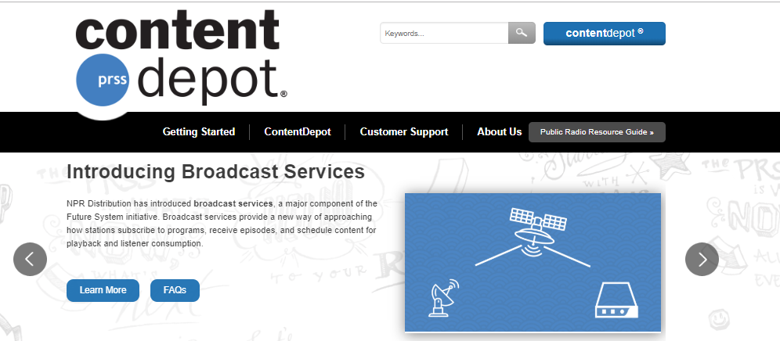
To Login Go to:
1. WWW.NPRDISTRIBUTION.ORG
2. Click Blue Button

Slide 3
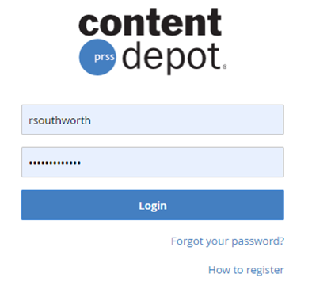
3. Enter Username
Enter Password
If you do not have a Content Depot login, send Lori Kesinger (lrk@ku.edu) or Renee an email with your name and email address. We will create one for you.
If you do not remember your password:
A. Try “Forgot your password” Link
B. Or, email rsouthworth@npr.org,
and I will reset it.

Slide 4
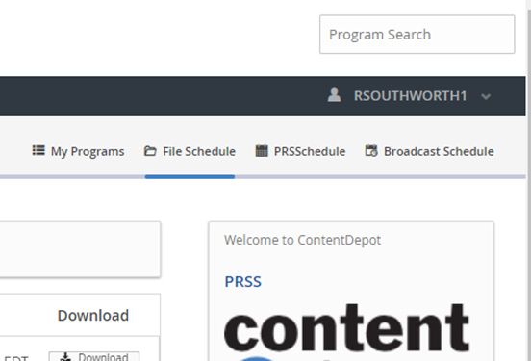
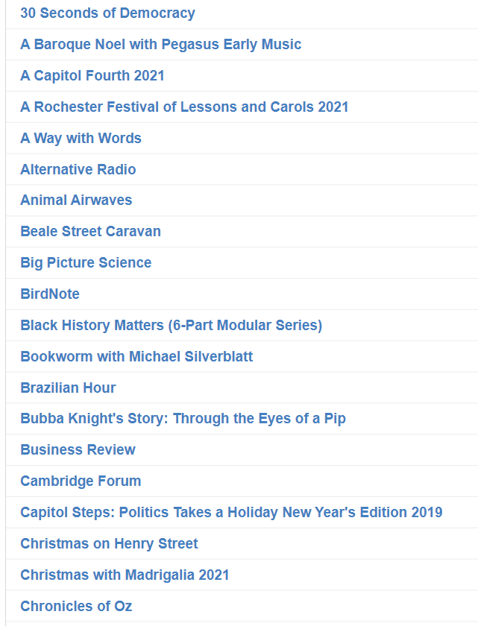
Click on “My Programs”
All subscribed programs will appear in alphabetical order

Slide 5
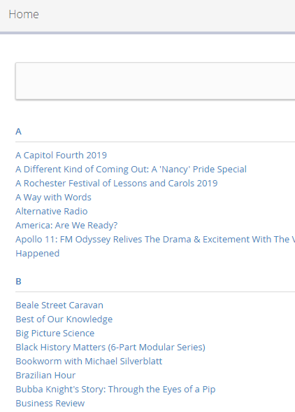
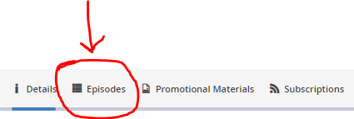
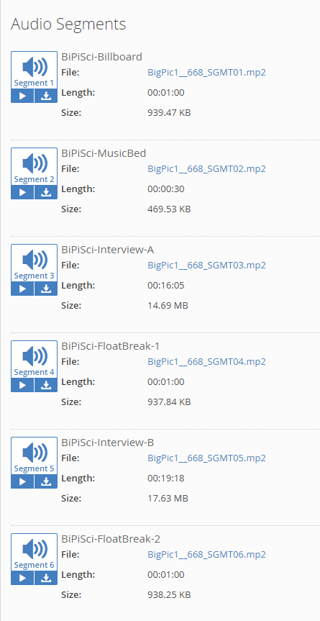
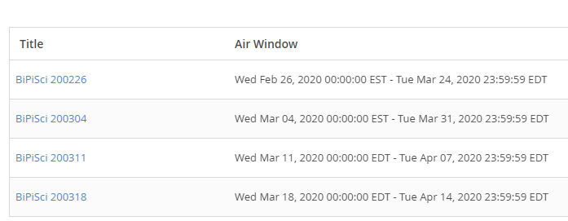
A. Click on program link to take you to that program page.
B. Once you are on the program page, click “Episodes” tab . This
will take you to program episodes.
Click on episode you wish to use.
Click on files you wish to download. ( All Segments Option)
A.
B.
D.
C.

Slide 6
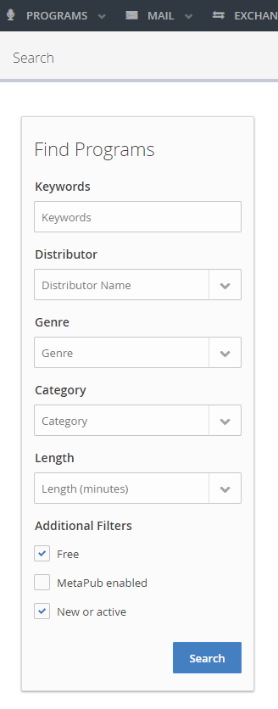
Search for Program Information by using the Program Search option
IAAIS is currently subscribed to all available free programming.
Your service is welcome to download any programming IAAIS is subscribed to.
IAAIS will subscribe to programming as it becomes available.

Slide 7
Free Content Depot Programs
0-2 Minutes
Animal Airwaves
BirdNote
Business Review
Earth Wise
Earth Date
Health in a Heartbeat
Insight Daily Radio
Shout! Black Gospel Music Moments
Sound Beat
The Academic Minute
The Loh Down on Science
Yale Climate Connections
16-30 Minutes (Weekly)
Best of Our Knowledge
Bookworm with Michael Silverblatt
46-60+ Minutes
City Arts & Lectures (weekly)
Commonwealth Club of California (weekly)
E-Town (weekly)
George Hirsch Lifestyle Radio (13 weeks)
Intelligence Squared US
Inspired Interfaith Voices (weekly)
KCRW’s Left Right & Center (weekly)
Masters of Scale
Movie Magazine & Shoestring Radio (weekly)
Our Body Politic (weekly)
Tech Nation (weekly)
The Treatment w/Elvis Mitchell
Think (daily)
Travel with Rick Steves (weekly)
With Good Reason (Hour)
Women in Music with Laney Goodman
WorldAffairs: Conversations that Matter
Cambridge Forum
Fifty-One Percent
Georgetown University Forum
Making Contact
New Letters on the Air
Person Place Thing
Planetary Radio
Texas Matters
The Book Show
The Business
The Media Project
With Good Reason (1/2 Hr version)
3-10 Minutes
Asian View
Black History Matters 6-Part Series
Engines of Our Ingenuity
KCRW’s Private Playlist
Profiles in Women's History (Modular Series)
Yale Climate Connections Special
46-60+ Minutes
A Way with Words (weekly)
Alternative Radio (weekly)
Beale Street Caravan (weekly)
Big Picture Science (weekly)
Brazilian Hour (weekly)
Bubba Knight's Story: Through the Eyes of a Pip

Slide 8
If you have any questions, need clarification or assistance,
please contact me.
Renee Southworth
rsouthworth@npr.org
(202) 513-2642

